Slide 1
MAD about SMS
Mobile App Distribution using Twilio
Rob Spectre, Dir. Devangelism
@dn0t – rspectre@twilio.com

Slide 2
HOLY BISCUITS

Slide 3
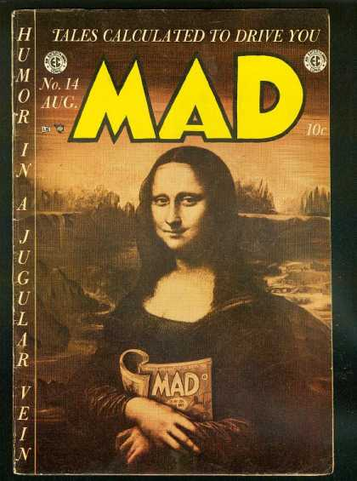
CALCULATED TALES

Slide 4
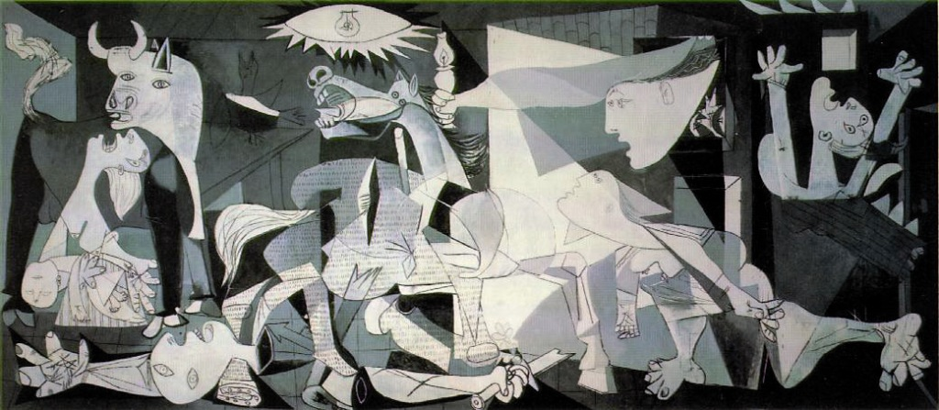
THE HORROR , THE HUMANITY

Slide 5
Tweetcaster
v4
normal
ICS
Gingerbread
320x480
xlarge
Gmail
Facebook
iOS
Sparrow
Android
Twitter
Default
small
v5
large
640x960
Honeycomb
v6
Tweetbot
Plume
CIRCLES, AW YEAH.

Slide 6
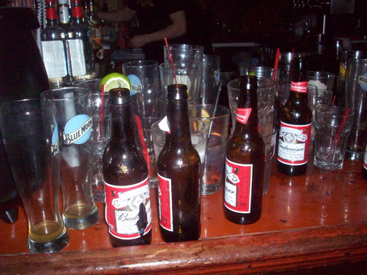
VENN WAS A DRINKER

Slide 7

WHAT, ME WORRY?

Slide 8
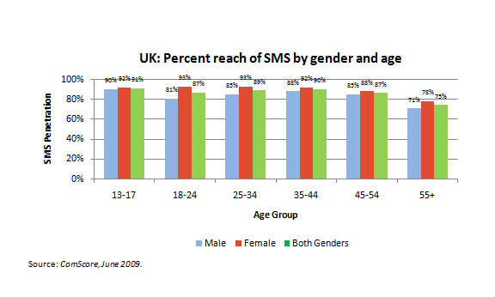
RESISTING ANOTHER BAR JOKE

Slide 9
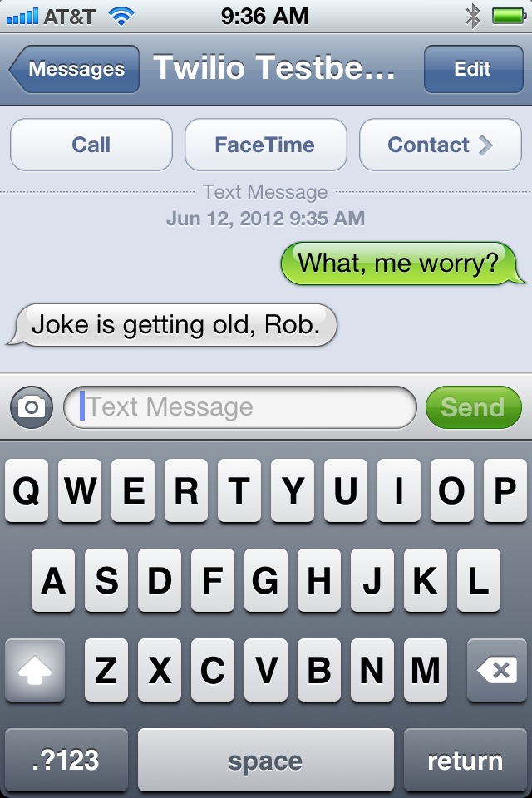
FLOGGING THAT HORSE

Slide 10
O HAI.

Slide 11
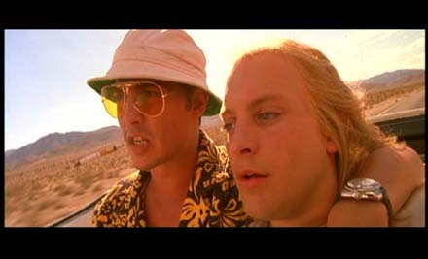
LET ME BRING YOU UP TO SPEED

Slide 12
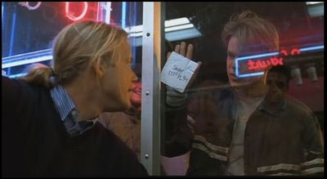
HOW DO YOU LIKE THEM APPLES?

Slide 13
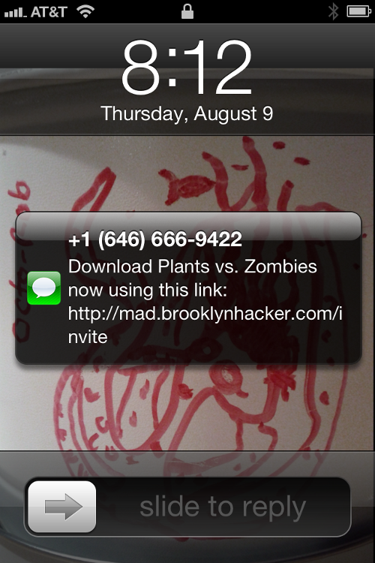
DOWNLOAD!

Slide 14
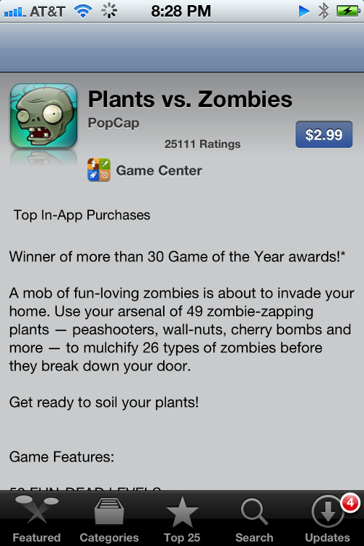
FIVE STAR EXPERIENCE

Slide 15
DO IT LIVE

Slide 16
KEY BENEFITS

Slide 17

DELIVERY IS CERTAIN

Slide 18

1 CENT. CHEAP!

Slide 19
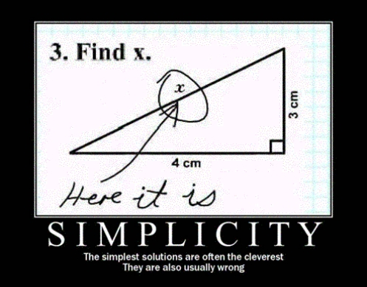
SIMPLE AS a² + b²

Slide 20
PRO TIPS

Slide 21

MORE THAN JUST INVITATIONS

Slide 22
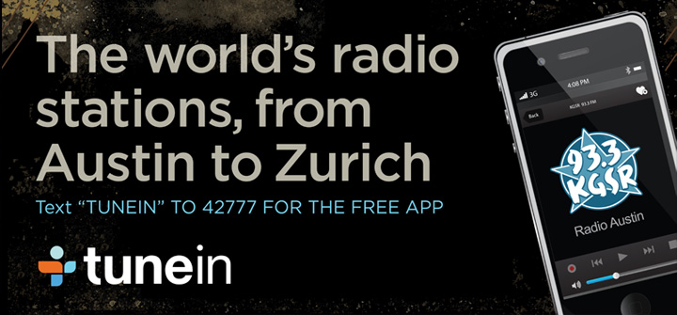
YOUR CREATIVES WANT SMS

Slide 23

REACH OUT AND TOUCH SOMEONE

Slide 24
CASE STUDIES

Slide 25
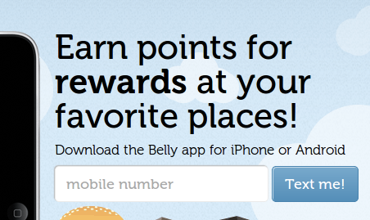
BELLY

Slide 26
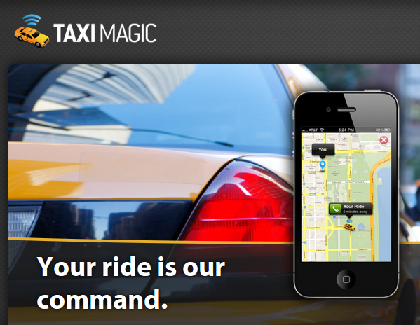
TAXIMAGIC

Slide 27
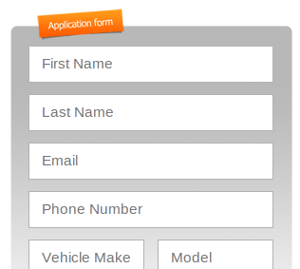
SIDECAR

Slide 28
THANK YOU
github.com/RobSpectre/Talks
@dn0t – rspectre@twilio.com

